Slide 1
Housing Project
By
SWATHI R

Slide 2
ACKNOWLEDGMENT
The internship opportunity I had with Flip Robo was a great chance for learning and professional development. Therefore, I consider myself as a very lucky individual as I was provided with an opportunity to be a part of it.
I would like to thank our SME for suggesting this project and for his whole hearted cooperation and constant encouragement throughout the project.
And I also like to thank the data trained mentors and Technical team members for helping me with the technical queries.
And these are the following website which I referred for the reference
https://www.kaggle.com/
https://scikit-learn.org/
www.stackoverflow.com
www.google.com
www.geeksforgeeks.org

Slide 3
Business Problem Framing
Houses are one of the necessary need of each and every person around the globe and therefore housing and real estate market is one of the markets which is one of the major contributors in the world’s economy. It is a very large market and there are various companies working in the domain.
Data science comes as a very important tool to solve problems in the domain to help the companies increase their overall revenue, profits, improving their marketing strategies and focusing on changing trends in house sales and purchases. Predictive modelling, Market mix modelling, recommendation systems are some of the machine learning techniques used for achieving the business goals for housing companies. Our problem is related to one such housing company. A US-based housing company named Surprise Housing has decided to enter the Australian market.
The company uses Logistic Regression is a part of the Supervised Learning method of Machine Learning. It is a statistical method for the analysis of a dataset. It has one or more independent variables that determine an outcome. There is one basic difference between Linear Regression and Logistic Regression which is that Linear Regression's outcome is continuous whereas Logistic Regression's outcome is only limited. Here, the outcome represents a dependent variable.

Slide 4
With the help of Pandas Library We will upload our data to Jupyter Notebook.
Once our data is uploaded with the help of predefined method (i.e. read_csv) we can read data for further processing.
We have two type of variables in the data:-
Dependent Variable
Independent Variable

Slide 5
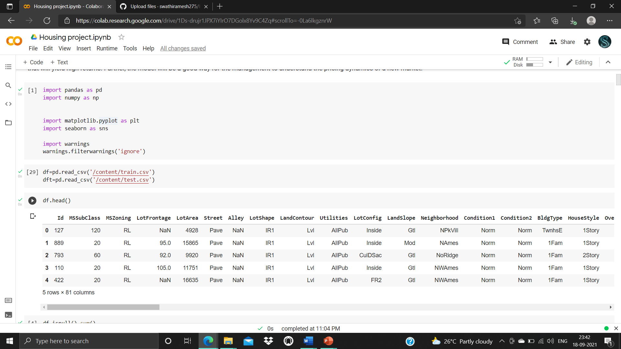
Data file

Slide 6
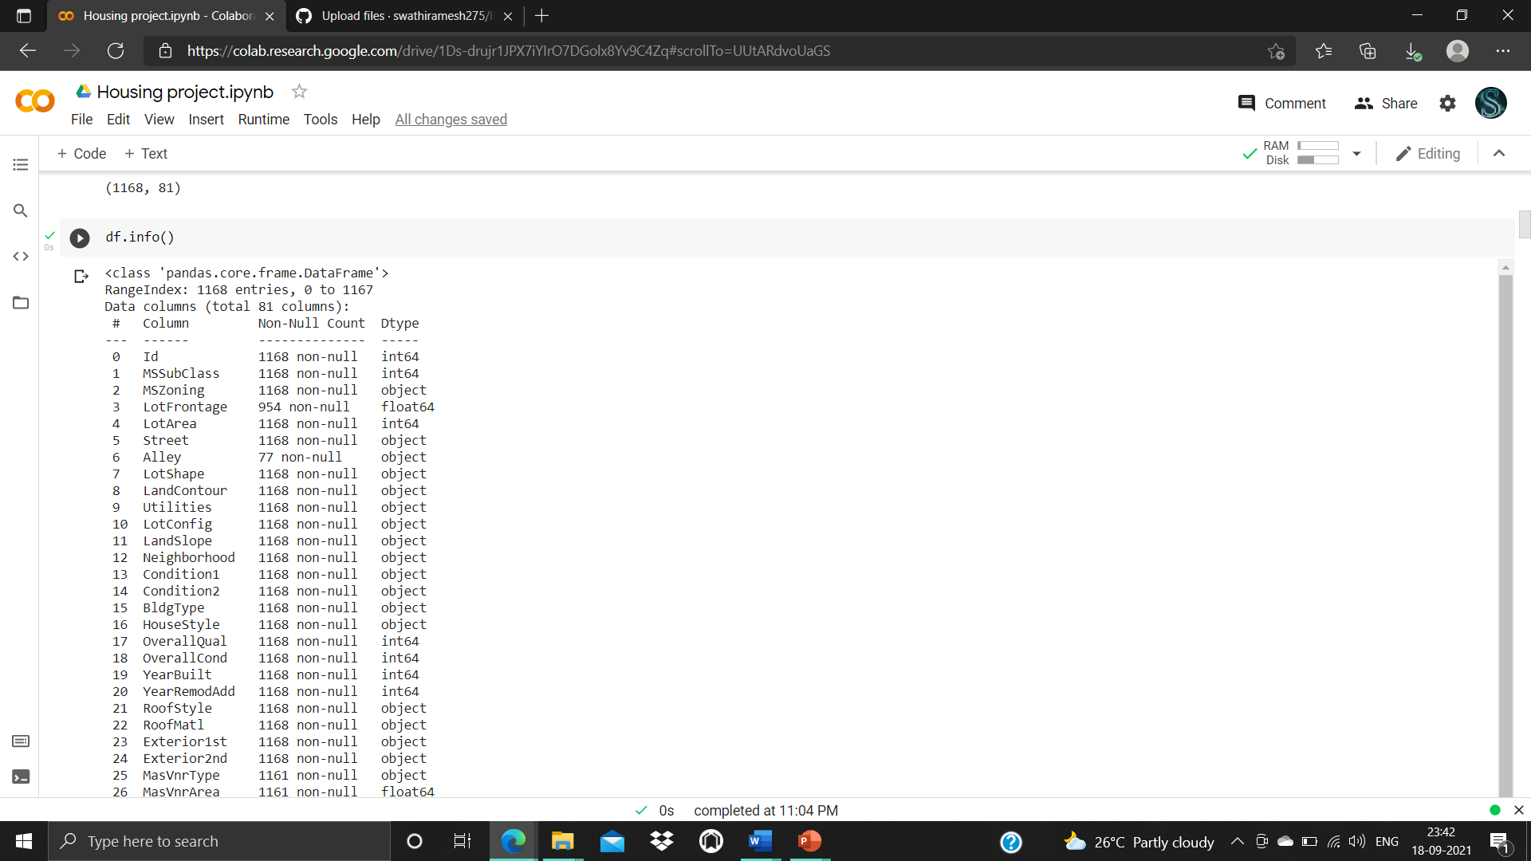
Label is an independent variable where as all of the other element are dependent variable.

Slide 7
Conceptual Background of the Domain Problem
In real estate the value of property usually increases with time as seen in many countries. One of the causes for this is due to rising population.
The value of property also depends on the proximity of the property, its size its neighbourhood and audience for which the property is subjected to be sold. For example if audience is mainly concerned of commercial purpose. Then the property which is located in densely populated area will be sold very fast and at high prices compared to the one located at remote place. Similarly if audience is concerned only on living place then property with less dense area having large area with all services will be sold at higher prices.
The company is looking at prospective properties to buy houses to enter the market. We are required to build a model using Machine Learning in order to predict the actual value of the prospective properties and decide whether to invest in them or not.

Slide 8
Motivation for the Problem Undertaken
To understand real world problems where Machine Learning and Data Analysis can be applied to help organizations in various domains to make better decisions with the help of which they can gain profit or can be escaped from any loss which otherwise could be possible without the study of data .One of such domain is Real Estate.
Houses are one of the necessary need of each and every person around the globe and therefore housing and real estate market is one of the markets which is one of the major contributors in the world’s economy. It is a very large market and there are various companies working in the domain. Data science comes as a very important tool to solve problems in the domain to help the companies increase their overall revenue, profits, improving their marketing strategies and focusing on changing trends in house sales and purchases. Predictive modelling, Market mix modelling, recommendation systems are some of the machine learning techniques used for achieving the business goals for housing companies. Our problem is related to one such housing company.

Slide 9
MODELS USED
Classification Model with following algorithms
Linear Regression
Random forest Regression
DecisionTree Regression
Evaluation metrics
Mean Absolute error
Mean square error
Root mean squared error
Varance
R2 score

Slide 10
Testing of Identified Approaches (Algorithms)
Listing down all the algorithms used for the training and testing.
LR=LinearRegression()
DT=DecisionTreeRegressor()
RF=RandomForestRegressor()

Slide 11
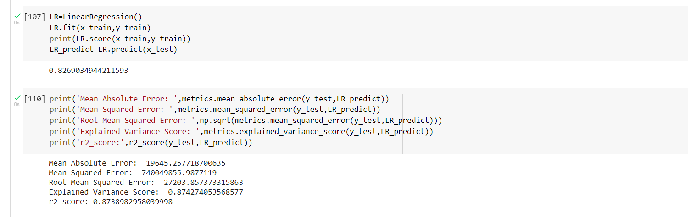
Run and Evaluate selected models
Describe all the algorithms used along with the snapshot of their code and what were the results observed over different evaluation metrics.
1.Linear Regressor

Slide 12
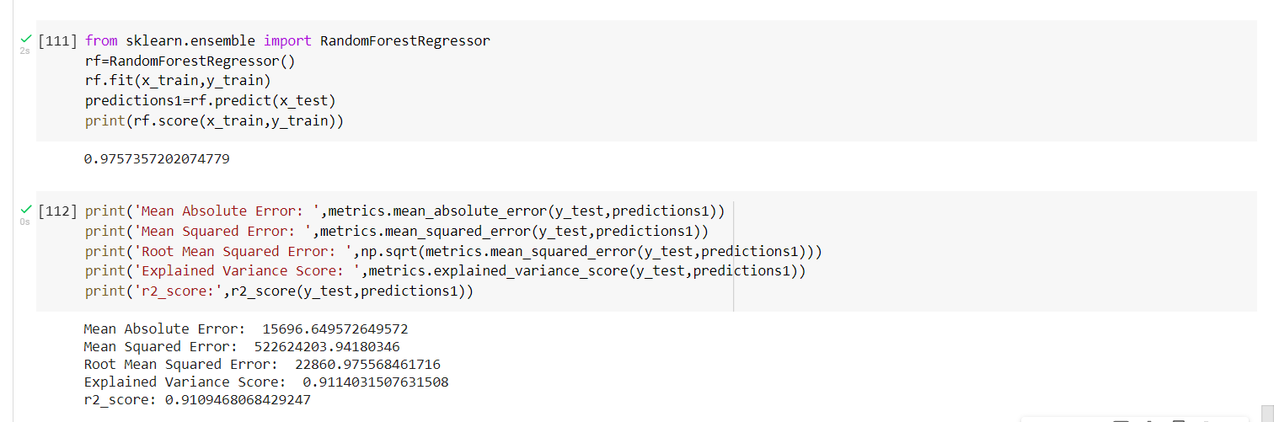
2.Random Forest Regressor

Slide 13
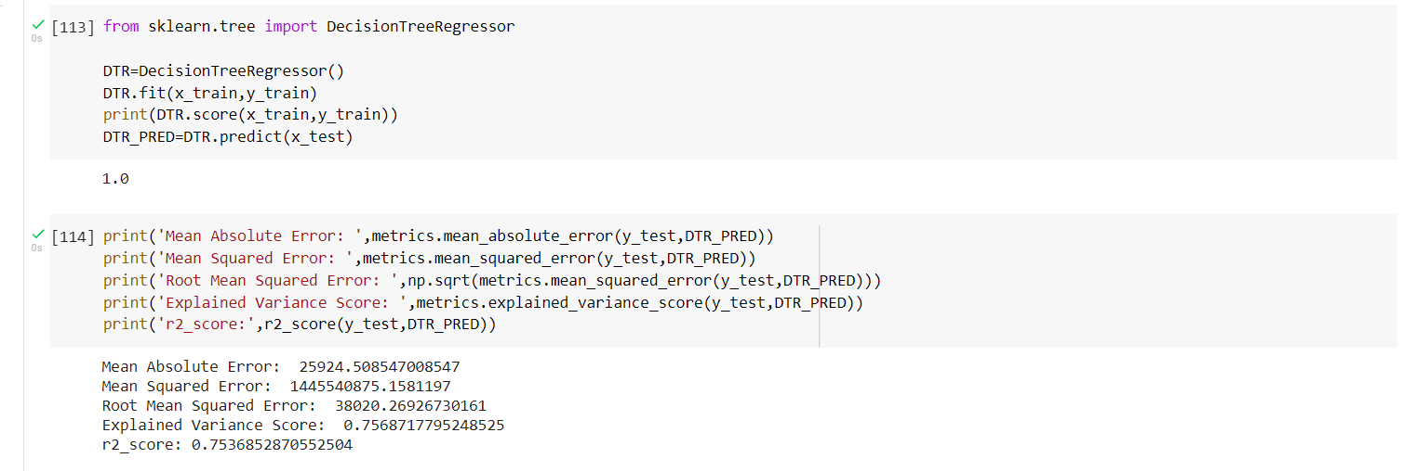
3. Decision Tree

Slide 14
RESULT
Totally 5 models are performed
KneighborsClassifier
LogisticRegression
DecisionTreeClassifier
GaussianNB
SVC
Among that Random Forest model have been chosen and performed hyper parameter tuning.
Then those Random Forest model is evaluated using the evaluation metrics and the best model is chosen.
The best model is Random Forest with
Mean Absolute Error: 15696.649572649572 Mean Squared Error: 522624203.94180346 Root Mean Squared Error: 22860.975568461716 Explained Variance Score: 0.9114031507631508 r2_score: 0.9109468068429247

Slide 15
Conclusion
I check the data first and uploaded the data in jupyter notebook and than I visualize the features ,Perform the preprocessing in the data and understand the relationship between different features.
I used both train-validation split and the cross validation to evaluate the model effectiveness to predict the target values.
At the end I applied the 3 predictive models in the data.
Then after performing all the model the best model is chosen as Random Forest with accuracy of 0.975.

Slide 16
THANK YOU

